Slide 1
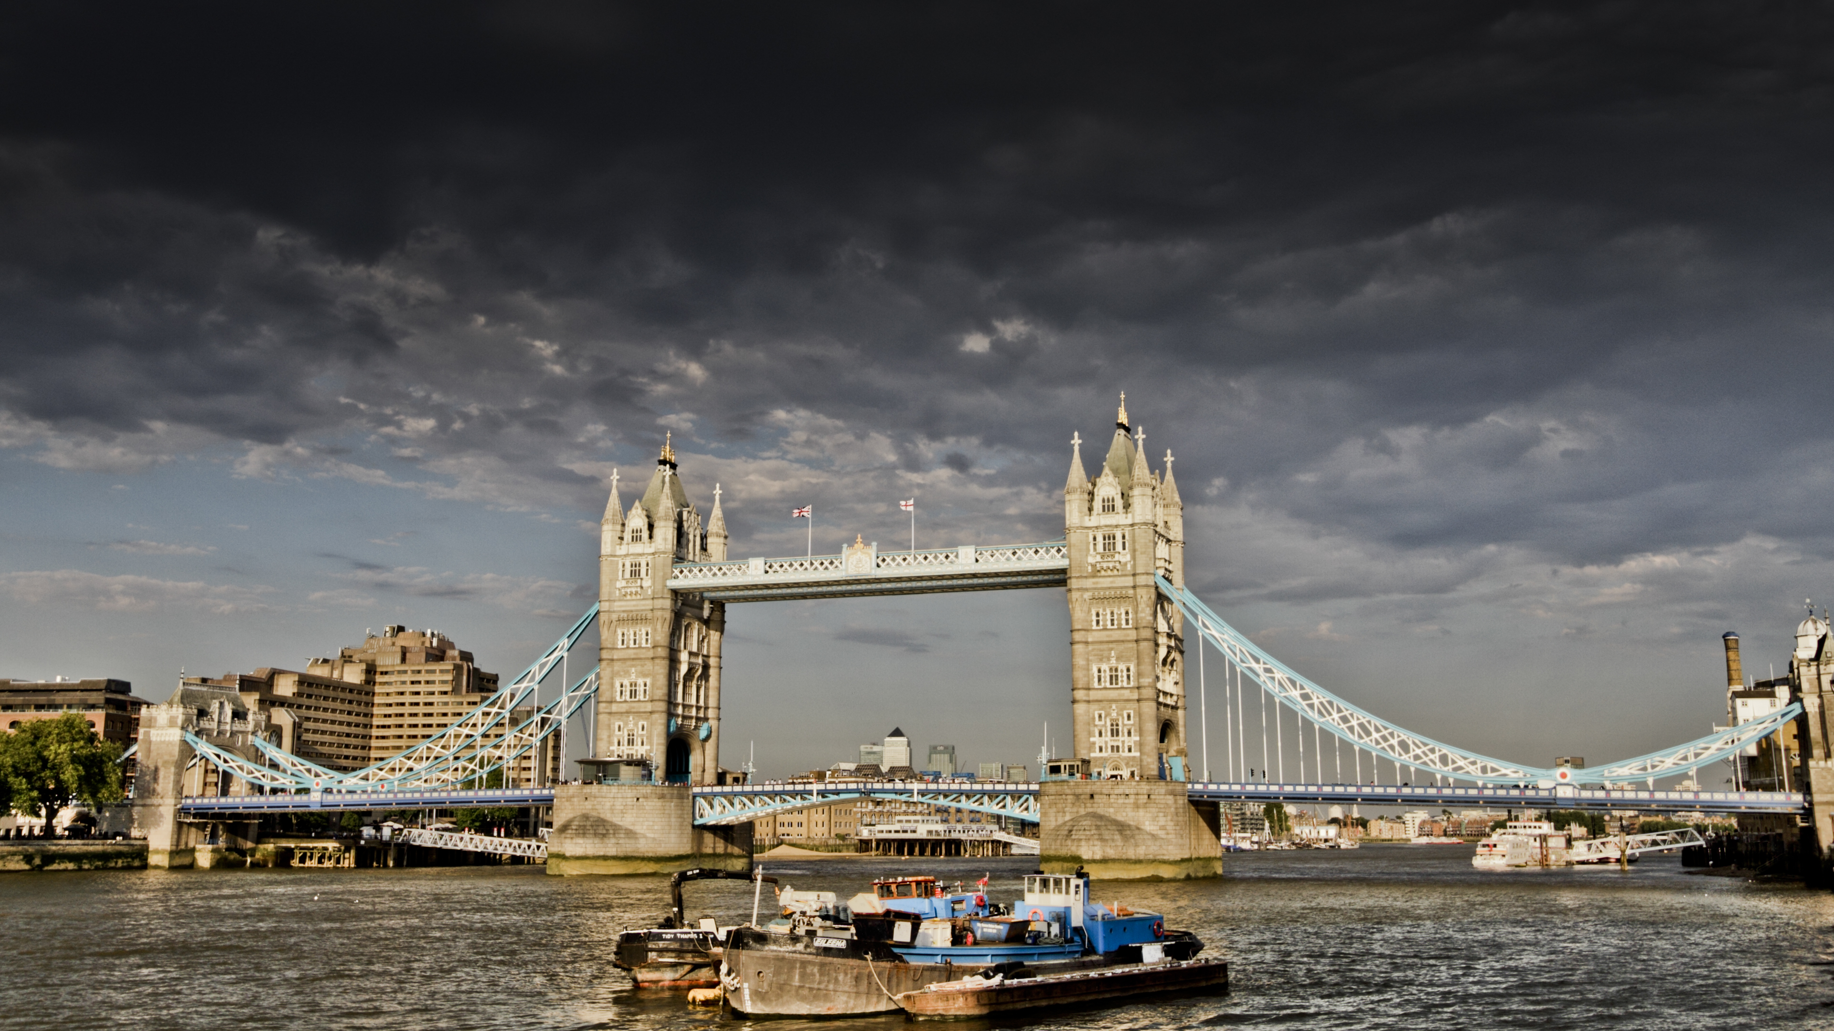
Image Processing in Parallel
Ben Moran and Alex Stone

Slide 2
Problem Definition
Processing is done serially pixel by pixel or small groups at a time
Pixels organized in 2D (X, Y) space
So most pixels are not reliant on others which opens it up to be parallelized.
Important because we manipulate images all time
We implemented compression, black and white color conversion, and brightness scale all in parallel
Used C# with built in functions for parallelizing like System.threading and System.Drawing.Imaging

Slide 3



Solution
We can assign threads their own section of an image to work on
Similar to thread distribution in vector, but in a 2D space
Split the image into p rectangles (using our partitioning formulas in class) and run the image manipulation on each rectangle

Slide 4
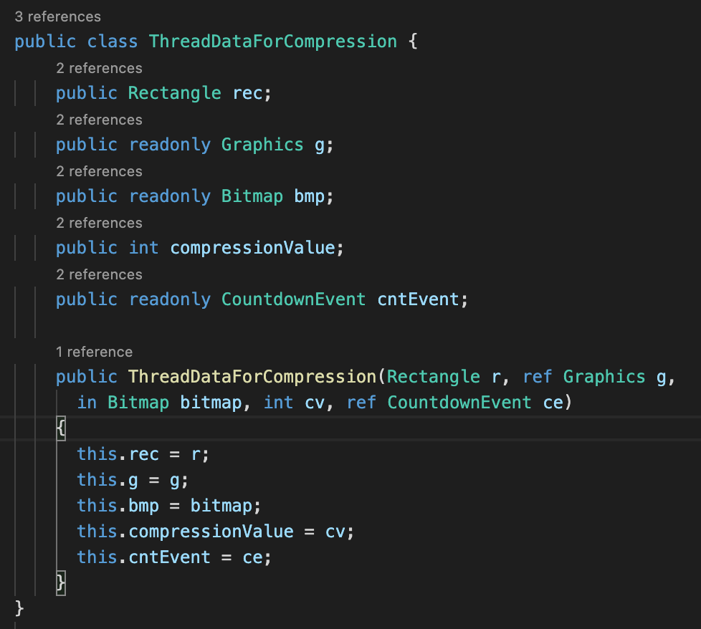
Code: Class to pass data

Slide 5
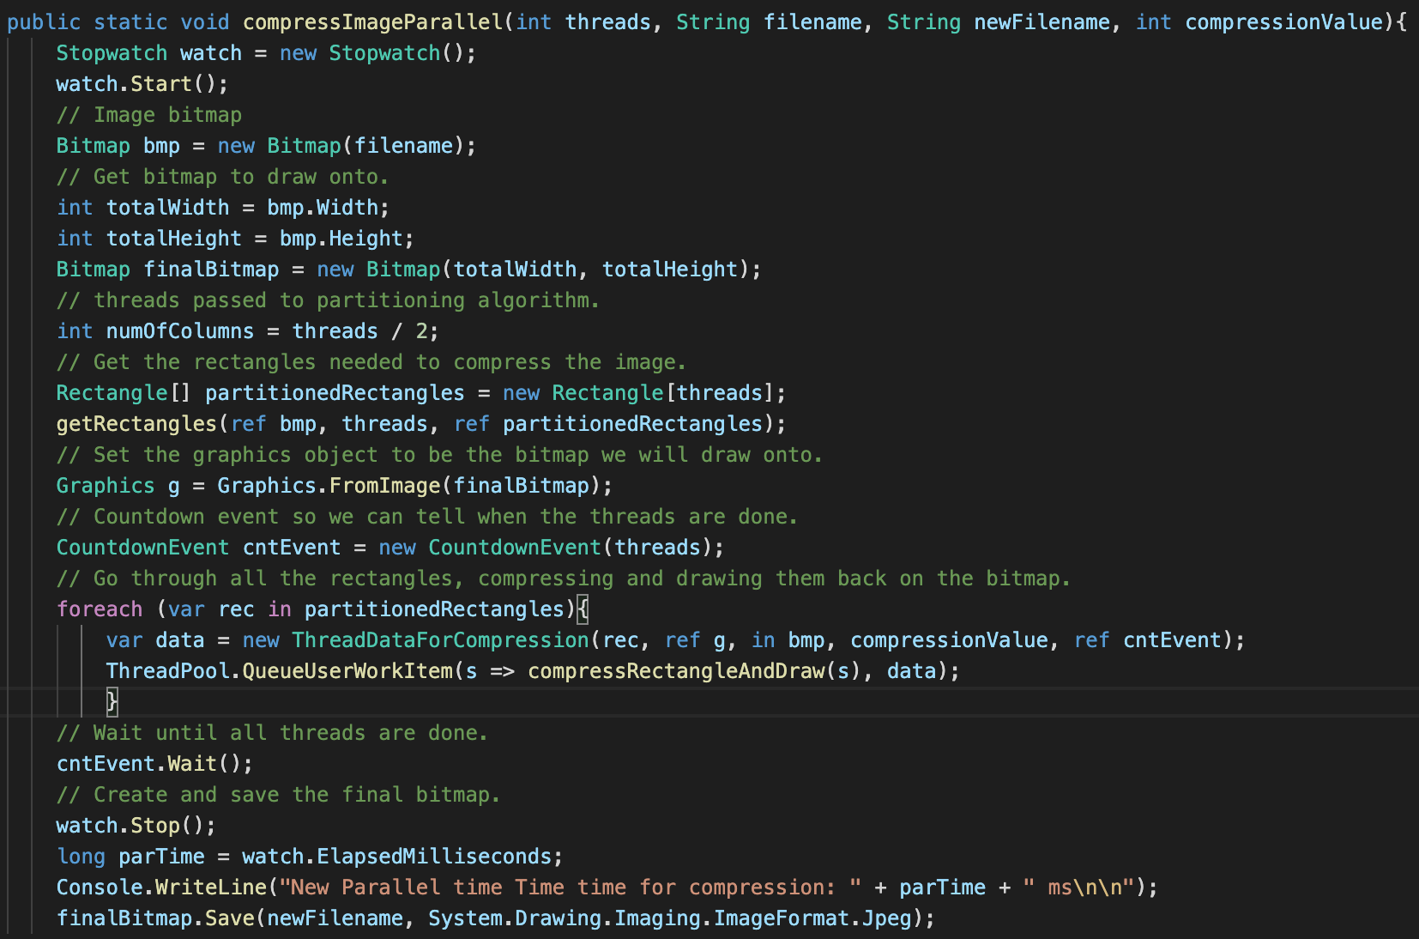
Code: Sending to thread pool

Slide 6
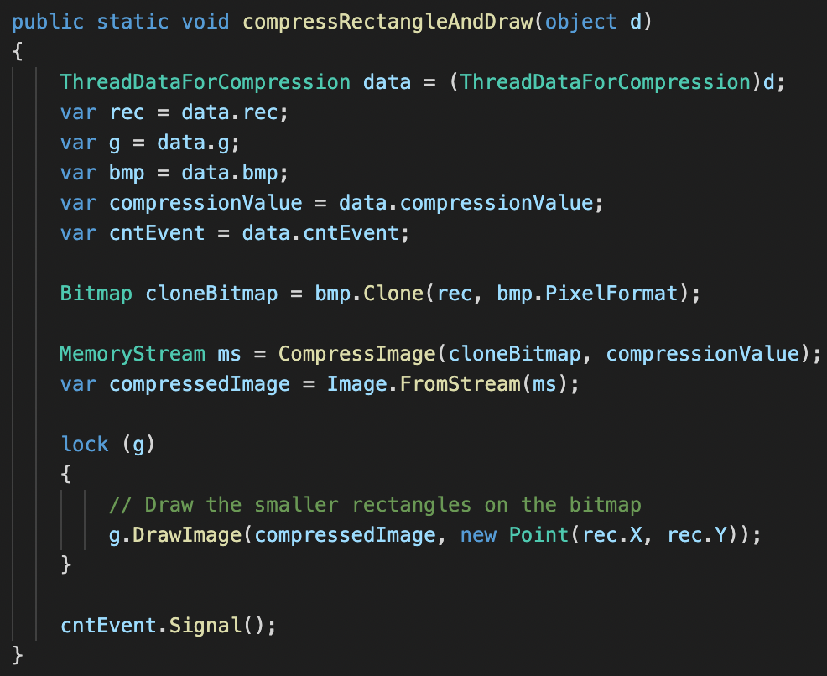
Code: Thread function

Slide 7
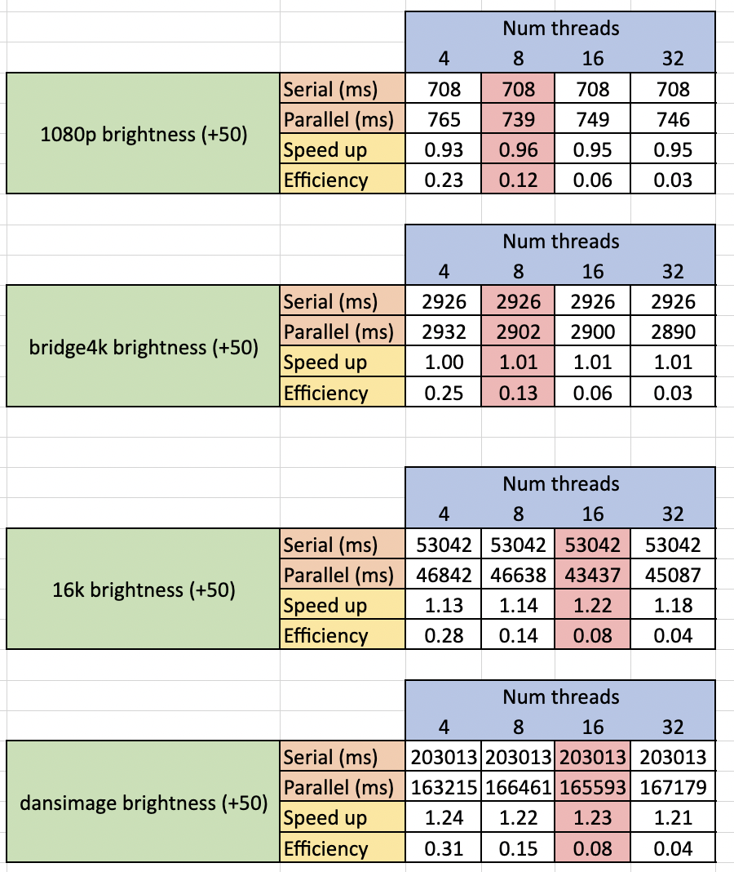


Timings – Brightness (Linux lab)

Slide 8
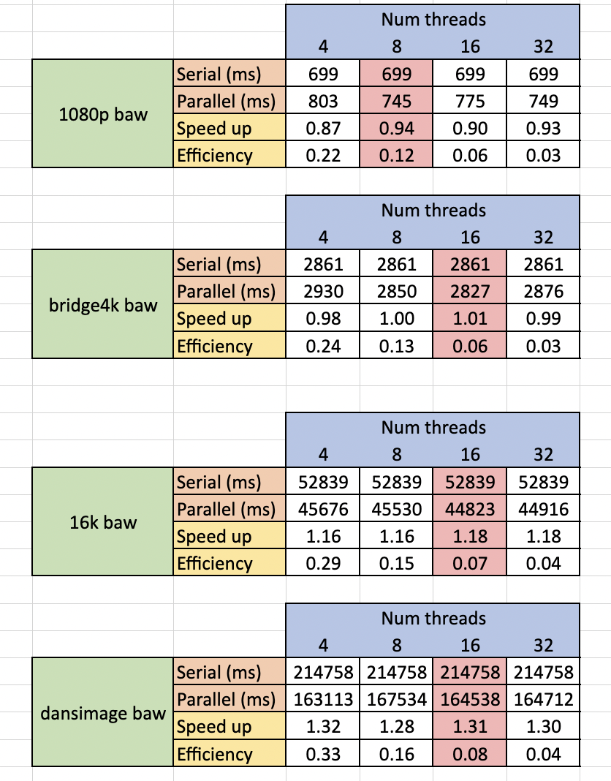
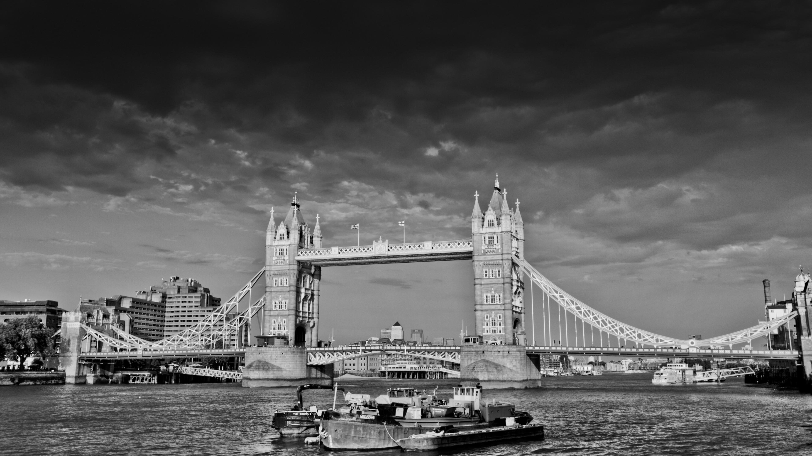
Timings – B&W (Linux lab)

Slide 9
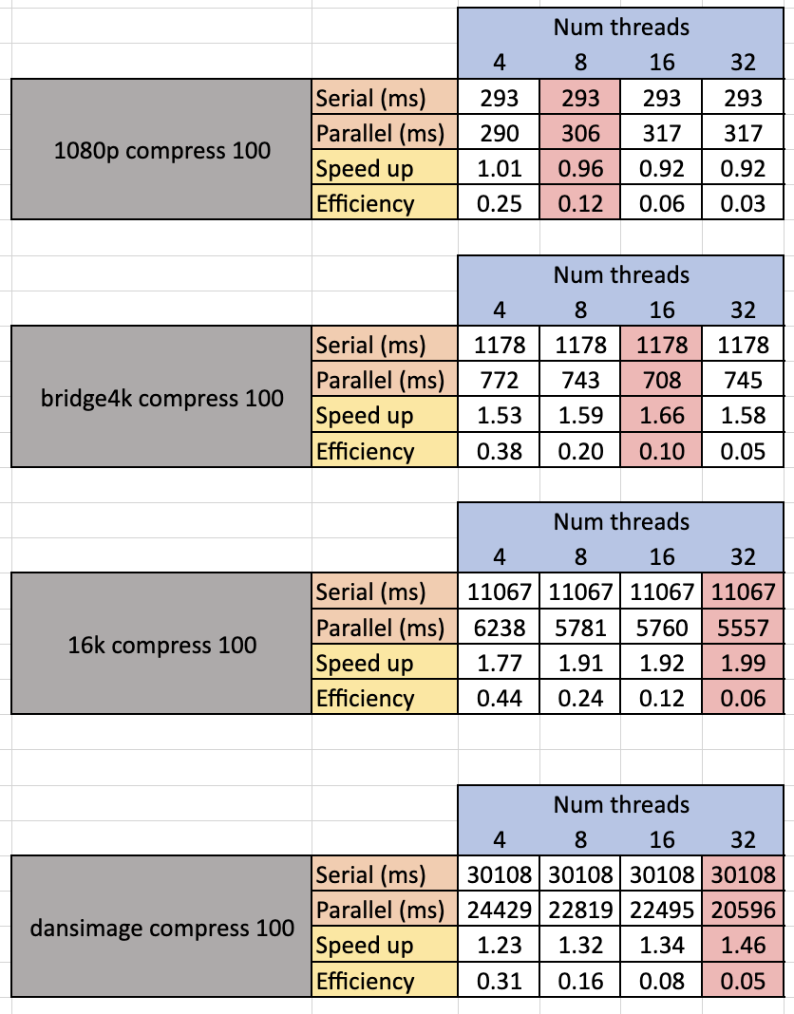

Timings – Compression (M1 chip)
From 13mb to 10mb using a compression value of 50

Slide 10
Results
Poor speedups at lower resolutions
Better speedups at very high res (4k-22k)
Much better performance on Apple's M1 chip compared to Linux lab
The bigger the image the more threads you want to use
Not a ton of great speedup but parallel is slightly faster

Slide 11
Conclusions
Is it effective?
Yes, at higher resolutions
Limitations:
Threads can be awkward to manage in C# which creates overhead
Picture must be large to get better performance
Only partition into 2 columns. Large pictures mean long skinny rectangles.
What can we improve?
Use a language with better support
Better C# libraries
Better partitioning algorithm and minimize overhead
Video support
CUDA implementation?

